Slide 1
Parallel Databases

Slide 2
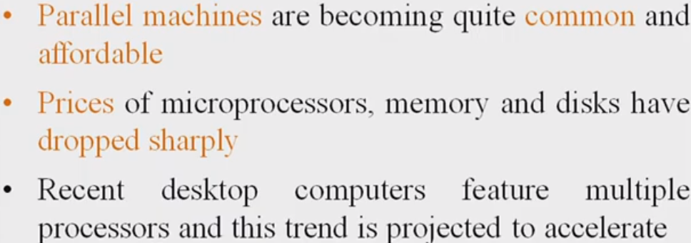
Need for Parallelism

Slide 3
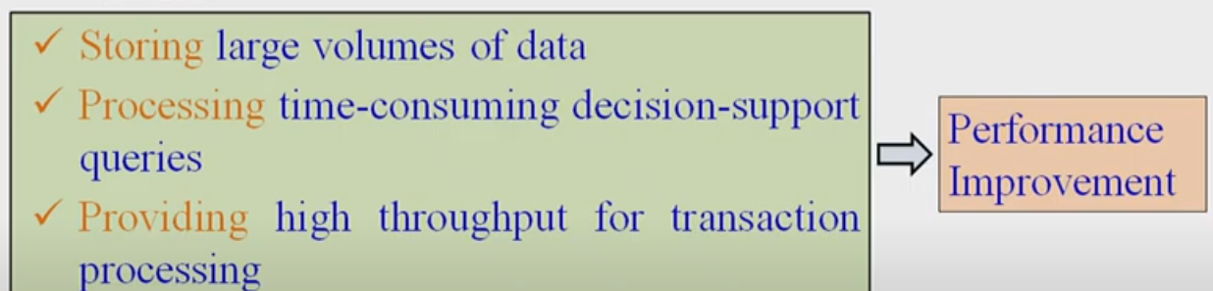
Goal of Parallelism
Large Scale Parallel database systems are used for:

Slide 4
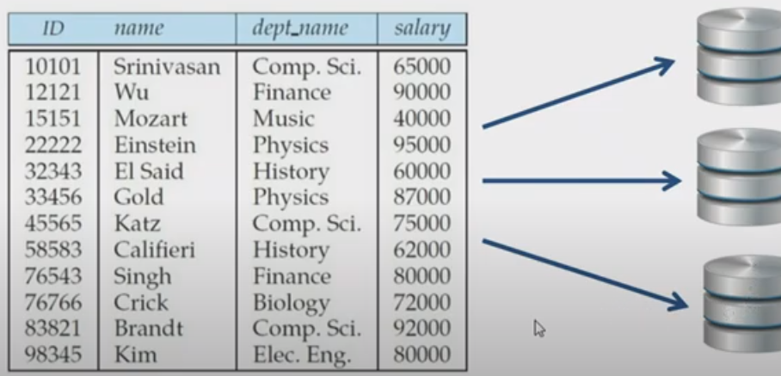
Parallelism in Databases

Slide 5
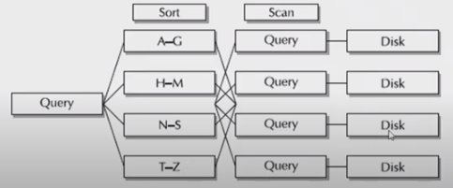
Parallelism in Databases
Relational Operations such as sort, join, aggregation can be executed in parallel

Slide 6
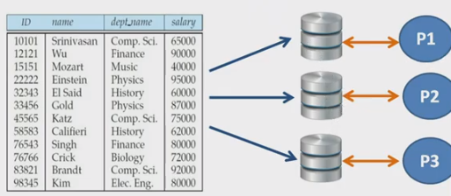
Data can be partitioned and each processor can work independently on its own partition

Slide 7
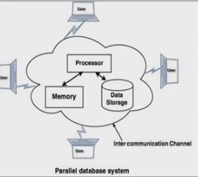
Parallel Database Architecture
Machines are physically close to each other (Eg. Same Server Room)
Machines connect with dedicated High Speed LANs and switches
Communication cost is assumed to be small
Can be Shared-Memory, Shared-Disk, Shared Nothing Architecture

Slide 8
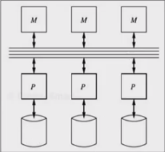
Shared Memory Architecture
Every Processor has its own disk
Single Memory Address Space for all processors
Reading or writing to far memory can be more expensive
Every processor cann have its own local memory and cache as well

Slide 9
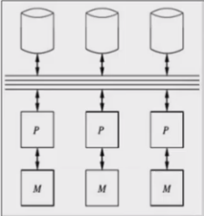
Shared Disk Architecture
Every processor has its own memory, not accessible by others
All machines can access all disks in the system
Number of disks does not necessarily match with the number of processors
Example: Digital Equipment Corporation (DEC) from Oracle is using SDA

Slide 10
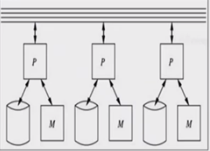
Shared Nothing Architecture
Most common architecture nowadays
Every machine has its own memory and disk
Many cheap machines (Commodity hardware)
Communication is done through high speed network and switches
Applications:
Tera data database machines
Grace and Gamma research
prototypes

Slide 11
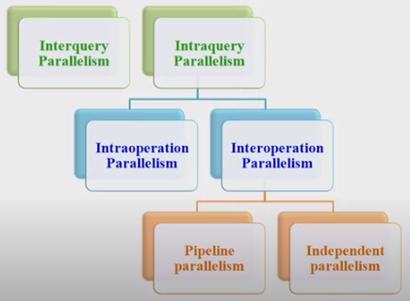
Forms of Query Parallelism

Slide 12
Inter Query Parallelism

Slide 13
Interquery parallelism refers to the ability of the database to accept queries from multiple applications at the same time.
Each query runs independently of the others, but the database manager runs all of them at the same time.
Db2 database products have always supported this type of parallelism.

Slide 14
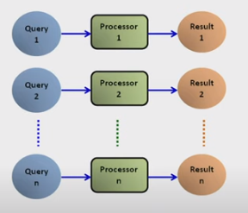
Inter Query Parallelism

Slide 15
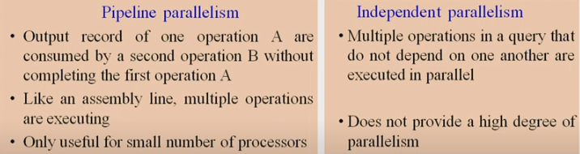
Inter Query Parallelism Types

Slide 16
Example of Interquery
If there are 6 queries, each query will take 3 seconds for evaluation. Thus, the total time taken to complete evaluation process is 18 seconds. Inter query parallelism achieves this task only in 3 seconds. However, Inter query parallelism is difficult to achieve every time.

Slide 17
Intra Query parallelism
In this technique query is divided in sub queries which can run simultaneously on different processors, this will minimize the query evaluation time.
Intra query parallelism improves the response time of the system.

Slide 18
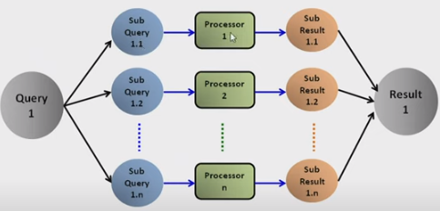
Intra Query

Slide 19
Example of Intra Query
If we have 6 queries, which can take 3 seconds to complete the evaluation process, the total time to complete the evaluation process is 18 seconds.
But We can achieve this task in only 3 seconds by using intra query evaluation as each query is divided in sub-queries.

Slide 20
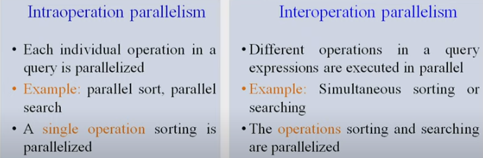
Query Parallelism

Slide 21
Optimization in Parallel Query
Parallel Query optimization is nothing but selecting the efficient query evaluation plan.
Parallel Query optimization plays an important role in developing system to minimize the cost of query evaluation.

Slide 22
Approaches to Query Optimization
Horizontal partitioning: Tables are created vertically using columns. Vertical partitioning: Tables are created with fewer columns and partition the table row wise. De-normalization: In this approach multiple tables are combined into one table.

Slide 23
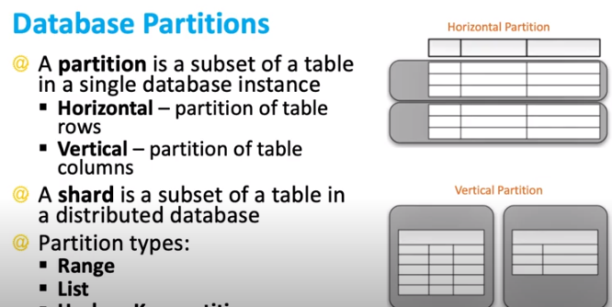

Slide 24
Grouping/Aggregation
Partition the relation on the grouping attributes and then compute the aggregate values locally at each processor.
Can reduce cost of transferring tuples during partitioning by partly computing aggregate values before partitioning.
Consider the sum aggregation operation:
Perform aggregation operation at each processor P_{i} on those tuples stored on disk D_{i}
results in tuples with partial sums at each processor.
Result of the local aggregation is partitioned on the grouping attributes, and the aggregation performed again at each processor P_{i} to get the final result.
Fewer tuples need to be sent to other processors during partitioning.

Slide 25
Interoperator Parallelism
Pipelined parallelism
Consider a join of four relations
r₁ r₂ r₃ r₄
Set up a pipeline that computes the three joins in parallel
Let P1 be assigned the computation of temp1 = r₁ r₂
And P2 be assigned the computation of temp2 = temp1 r₃
And P3 be assigned the computation of temp2 r₄
Each of these operations can execute in parallel, sending result tuples it computes to the next operation even as it is computing further results
Provided a pipelineable join evaluation algorithm (e.g., indexed nested loops join) is used

Slide 26
Distributed Databases

Slide 27
DDBMS
A Distributed Database Management System (DDBMS) contains a single logical database that is divided into a number of fragments.
Every fragment gets stored on one or more computers under the control of a separate DBMS, with the computers connected by a communications network.

Slide 28
Use of DDBMS
Distributed databases offer location transparency of data with local autonomy.
This means that even though applications might not know where exactly the data resides, each site has the capability to control local data, administer security, keep track of transactions and recover when local site failures occur

Slide 29
Features
Location independent.
Distributed query processing.
Distributed transaction management.
Hardware independent.
Operating system independent.
Network independent.
Transaction transparency.
DBMS independent.

Slide 30
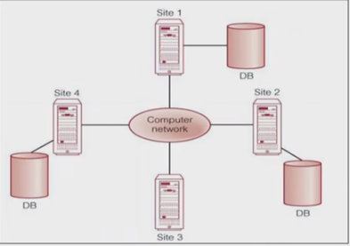
DDBMS
Data is physically stored across several sites
Each site is managed by an independent DBMS

Slide 31
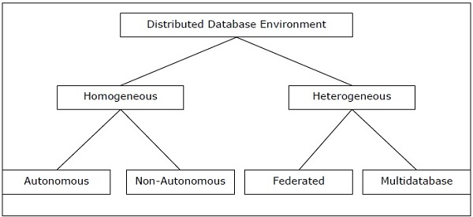
Types of DDBMS

Slide 32
Homogeneous DDBMS
The sites use very similar software.
The sites use identical DBMS or DBMS from the same vendor.
Each site is aware of all other sites and cooperates with other sites to process user requests.
The database is accessed through a single interface as if it is a single database.

Slide 33
Heterogeneous DDBMS
Different sites use dissimilar schemas and software.
The system may be composed of a variety of DBMSs like relational, network, hierarchical or object oriented.
Query processing is complex due to dissimilar schemas.
Transaction processing is complex due to dissimilar software.
A site may not be aware of other sites and so there is limited co-operation in processing user requests.

Slide 34
Types of Heterogeneous DDBMS
Federated − The heterogeneous database systems are independent in nature and integrated together so that they function as a single database system.
Un-federated − The database systems employ a central coordinating module through which the databases are accessed.

Slide 35
DDBMS Architectural Models
Client - Server Architecture for DDBMS
Peer - to - Peer Architecture for DDBMS
Multi - DBMS Architecture

Slide 36
Two different types of Client Server Architecture
Single Server Multiple Client
Multiple Server Multiple Client

Slide 37
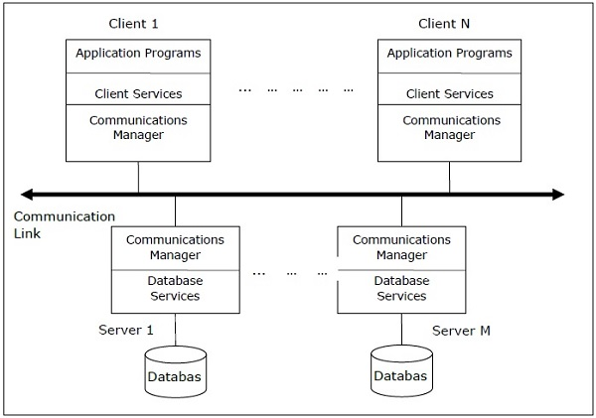
Client Server Architecture

Slide 38
Peer to Peer Architecture of DDBMS
Global Conceptual Schema − Depicts the global logical view of data.
Local Conceptual Schema − Depicts logical data organization at each site.
Local Internal Schema − Depicts physical data organization at each site.
External Schema − Depicts user view of data.

Slide 39
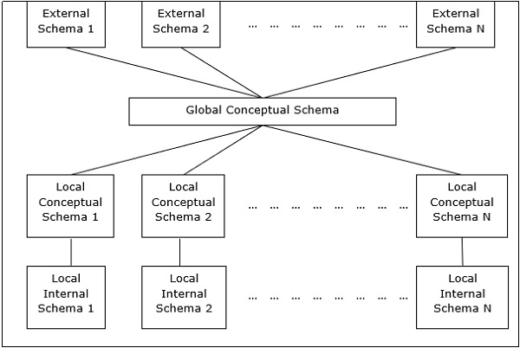
Peer to Peer Architecture

Slide 40
Multi DDBMS Architecture
Multi-database View Level − Depicts multiple user views comprising of subsets of the integrated distributed database.
Multi-database Conceptual Level − Depicts integrated multi-database that comprises of global logical multi-database structure definitions.
Multi-database Internal Level − Depicts the data distribution across different sites and multi-database to local data mapping.
Local database View Level − Depicts public view of local data.
Local database Conceptual Level − Depicts local data organization at each site.
Local database Internal Level − Depicts physical data organization at each site.

Slide 41
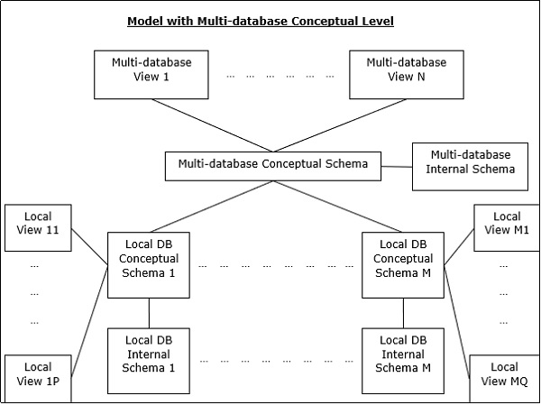
Multi DDBMS Architecture

Slide 42
Design Alternatives
Non-replicated and non-fragmented
Fully replicated
Partially replicated
Fragmented
Mixed

Slide 43
Fragmentation
Fragmentation is a process of dividing the whole or full database into various subtables or sub relations so that data can be stored in different systems.
The small pieces of sub relations or subtables are called fragments.
These fragments are called logical data units and are stored at various sites.
It must be made sure that the fragments are reconstructed to the original relation

Slide 44
Data Fragmentation
If a table T is fragmented and is divided into a number of fragments say T1, T2, T3….TN.
The fragments contain sufficient information to allow the restoration of the original table T.
This restoration can be done by the use of UNION or JOIN operation on various fragments. This process is called data fragmentation, by this way, fragmentation transparency is achieved

Slide 45
Types of Fragmentation
Horizontal fragmentation
Vertical fragmentation
Mixed or Hybrid fragmentation

Slide 46
Horizontal Fragmentation
Horizontal fragmentation refers to the process of dividing a table horizontally by assigning each row or (a group of rows) of relation to one or more fragments.
These fragments are then be assigned to different sides in the distributed system.
σ_{p}(T)
where, σ is relational algebra operator for selection
p is the condition satisfied by a horizontal fragment

Slide 47
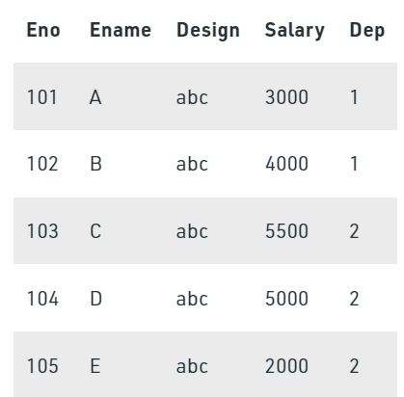
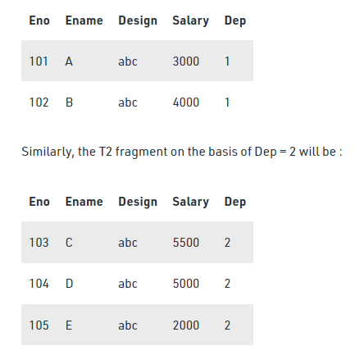
Example T = T1 U T2 U…Tn

Slide 48
Vertical Fragmentation
Vertical fragmentation refers to the process of decomposing a table vertically by attributes are columns.
π_{a1, a2,…, an} (T)
where, π is relational algebra operator
a1…., an are the aatriubutes of T
T is the table (relation)

Slide 49
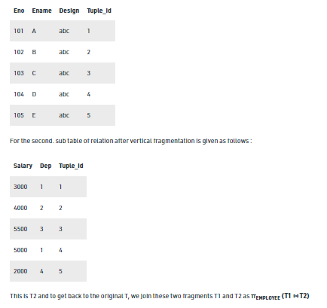
Vertical Frag Example

Slide 50
Mixed Fragmentation
The combination of vertical fragmentation of a table followed by further horizontal fragmentation of some fragments is called mixed or hybrid fragmentation.
The first method is to first create a set or group of horizontal fragments and then create vertical fragments from one or more of the horizontal fragments.
The second method is to first create a set or group of vertical fragments and then create horizontal fragments from one or more of the vertical fragments.
The original relation can be obtained by the combination of JOIN and UNION operations which is given as follows:
σ_{P}(π_{a1, a2..,an}(T))
π_{a1,a2….,an} (σ_{p}(T))

Slide 51
Replication
Database replication involves copying, transferring, or integrating data from one database in a server or computer to another, eventually creating a distributed database.
After data replication takes place, users have access to the same information, which improves consistency, reliability, and performance.

Slide 52
Distributed Query Processing
For centralized systems, the primary criterion for measuring the cost of a particular strategy is the number of disk accesses.
In a distributed system, other issues must be taken into account:
The cost of a data transmission over the network.
The potential gain in performance from having several sites process parts of the query in parallel.

Slide 53
Par &dist Query processing
The world of parallel and distributed query optimization
Parallel world, invent parallel versions of well-known algorithms, mostly based on broadcasting tuples and dataflow driven computations
Distributed world, use plan modification and coarse grain processing, exchange large chunks

Slide 54
Simple Distributed Join Processing
Consider the following relational algebra expression in which the three relations are neither replicated nor fragmented
account depositor branch
account is stored at site S₁
depositor at S₂
branch at S₃
For a query issued at site S_{I}, the system needs to produce the result at site S_{I}

Slide 55
Possible Query Processing Strategies
Ship copies of all three relations to site S_{I} and choose a strategy for processing the entire locally at site S_{I.}
Ship a copy of the account relation to site S₂ and compute temp₁ = account depositor at S₂. Ship temp₁ from S₂ to S₃, and compute temp₂ = temp₁ branch at S₃. Ship the result temp₂ to S_{I}.
Devise similar strategies, exchanging the roles S₁, S₂, S₃
Must consider following factors:
amount of data being shipped
cost of transmitting a data block between sites
relative processing speed at each site

Slide 56
Semijoin Strategy
Let r₁ be a relation with schema R₁ stores at site S₁
Let r₂ be a relation with schema R₂ stores at site S₂
Evaluate the expression r₁ r₂ and obtain the result at S₁.
1. Compute temp₁ ← ∏_{R1 ∩ R2} (r1) at S1.
2. Ship temp₁ from S₁ to S₂.
3. Compute temp₂ ← r₂ temp1 at S₂
4. Ship temp₂ from S₂ to S₁.
5. Compute r₁ temp₂ at S₁. This is the same as r₁ r₂.

Slide 57
Distributed Transaction Processing (DTP)
DTP lets you process data at the point where it arises, instead of overworking network resources by assembling it at a central processing point.
DTP does the following: Allows some measure of parallel processing to shorten response times

Slide 58
Distributed Transaction Service
The Distributed Transaction Coordinator service provides services designed to ensure successful and complete transactions, even with system failures, process failures, and communication failures

Slide 59
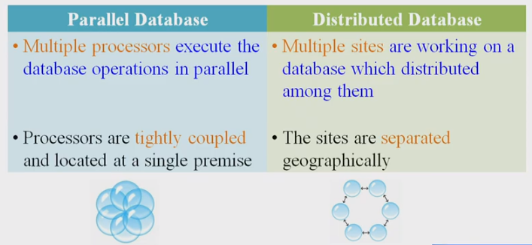
Difference Between Parallel and Distributed Databases

Slide 60
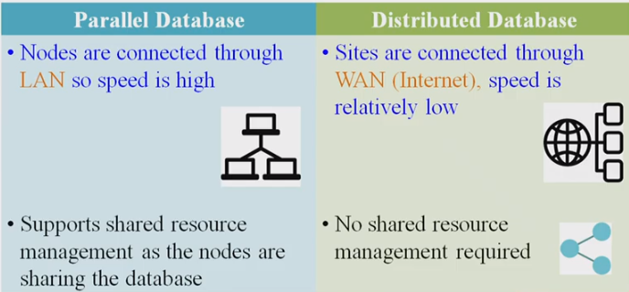
Parallel and Distributed DBMS

Slide 61
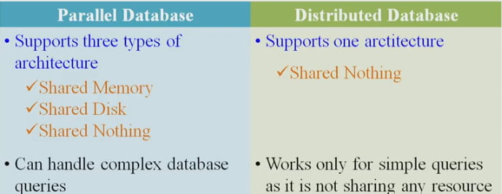
Parallel and Distributed DBMS

Slide 62
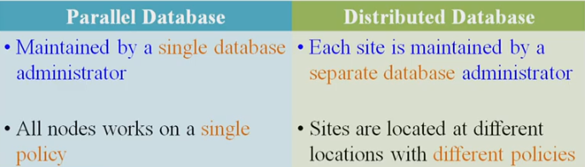
Parallel and Distributed DBMS

Slide 63
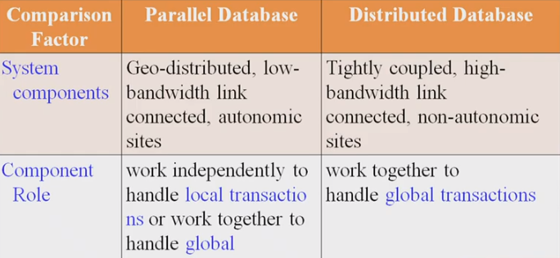
Comparisons

Slide 64
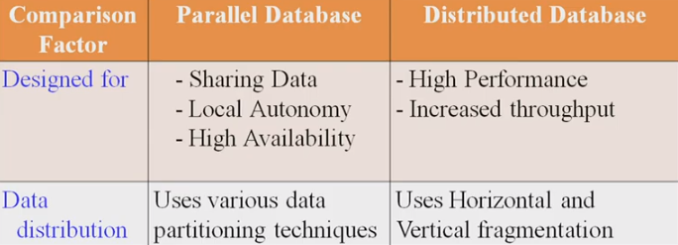
Comparisons

Slide 65
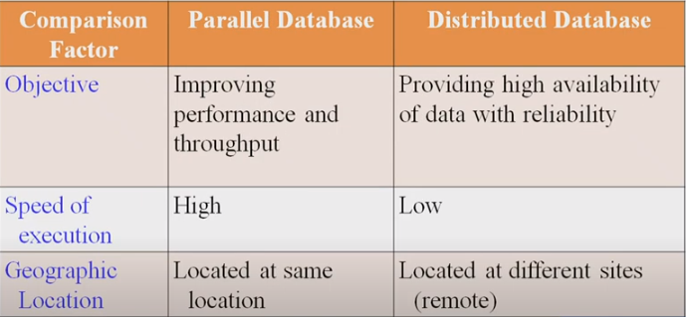
Comparisons

Slide 66
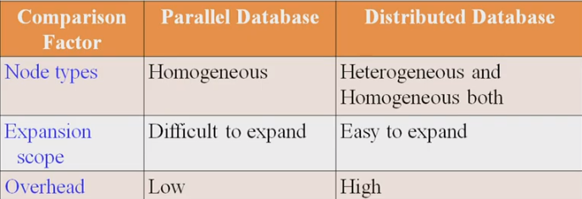
Comparisons

Slide 67
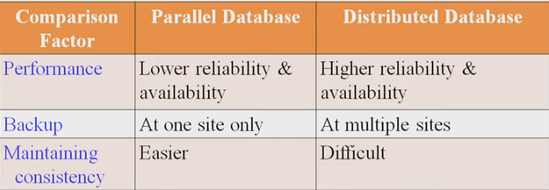
Comparisons

Slide 68
Spatial Databases

Slide 69
Spatial Database
Spatial database is a general-purpose database (usually a relational database) that has been enhanced to include spatial data that represents objects defined in a geometric space, along with tools for querying and analyzing such data.
A road map is a visualization of geographic information.
A road map is a 2-dimensional object which contains points, lines, and polygons that can represent cities, roads, and political boundaries such as states or provinces.
Rastor data: This data is represented as a matrix of square cells

Slide 70
Spatial Datatypes
raster data
vector data
LiDAR data (also known as point clouds) and 3D data
Spatial Relationships Types. Adjacency, contiguity, overlap, and proximity are the four ways of describing the relationship between two or more entities.

Slide 71
Phenomena/entities that exist in the real
world
Computer Representation
Machine Code
10011101
00110110
10110100
An abstraction, relevant phenomena and properties
71
Notes:
Entities are represented by spatial features or cartographic objects.
You are making choices, so remember that your choices are introducing a bias What is represented and how it is represented and what properties are recorded depend upon the intended use of the GIS.
This is subjective and adds a bias to the data.
Graphically, the boundary of the wetland may vary.
The attributes you choose depends upon your interest:
A forester might record the type of tree, the diameter at breast height and the health of the tree, where as someone interested in the hydrology might simply record tree.

Slide 72
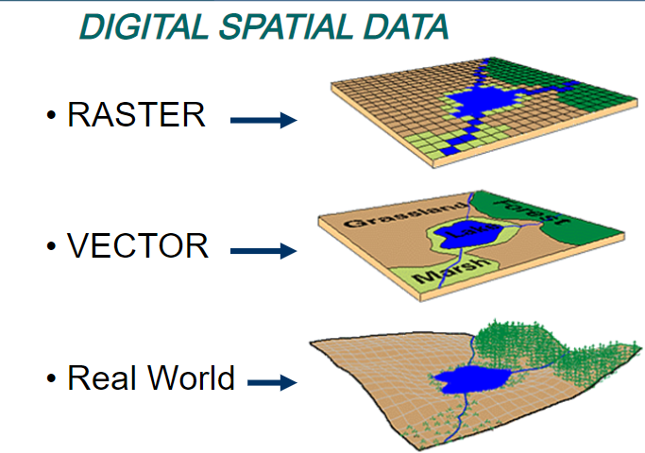

Slide 73
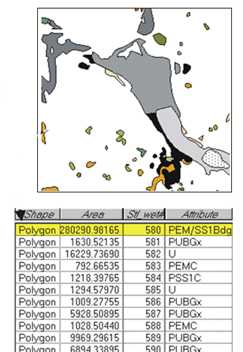
Data Model
Objects in a spatial database.
The spatial data model provides a formal means of representing and manipulating spatially-referenced information.
73
Notes:
So our data model is how the information is represented on a map and its representation in our database. There are two primary data models. This is example is a vector data model. The lake is represented as a polygon, and our database contains that information. This is the information that is normally visible to the user of the GIS.
Everything else is hidden and is more the concern of computer scientists except for the coordinates of our spatial features.
In order to locate something on the surface of the earth, our spatial feature needs to have either a coordinate pair (x,y) or coordinate triplet (x,y,z).
This information is normally hidden from the user, but we can access it.

Slide 74
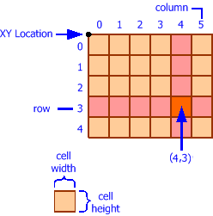
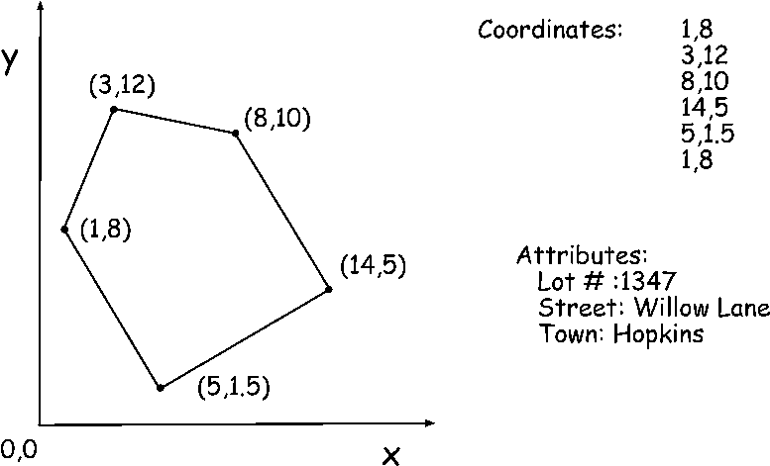
Coordinates
Coordinates are used to define the location and extent of spatial objects.
https://www.codeproject.com/Articles/44389/Build-a-Desktop-GIS-Application-Using-MapWinGIS

Slide 75
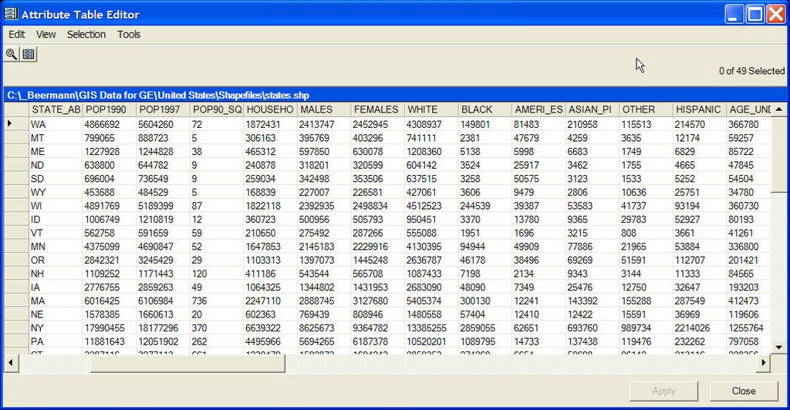
Attributes
Attributes describe the spatial object.
Attribute data complements the coordinate data to define the spatial object.

Slide 76
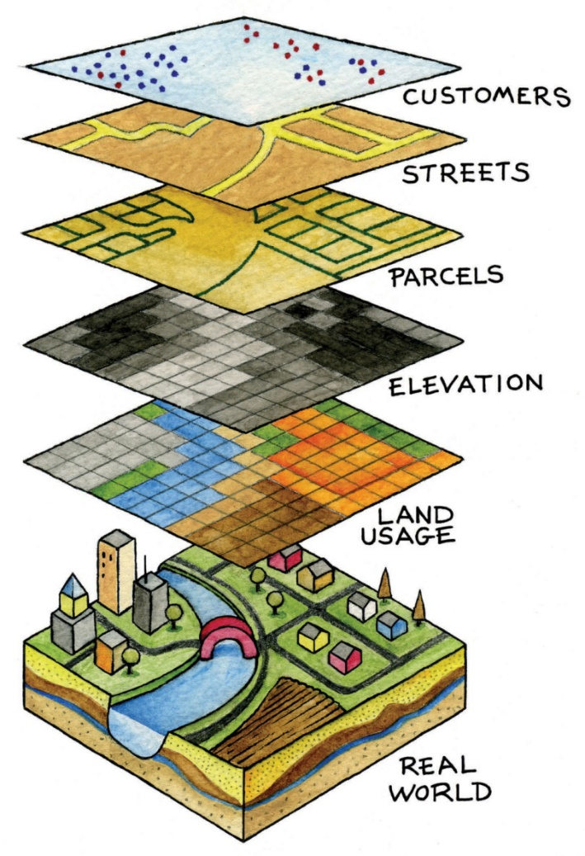
Thematic Layers
A logical separation of data according to theme.
Each layer reflects a particular use or characteristic.
Overlays.
Lecture 2
76
Notes:
Most conceptualizations view the world as thematic layers (just layers)
. In any given project you can have different data models.
Through analyses, data layers can be combined to create new layers, but analyses can only be done on a single data model at a time.

Slide 77
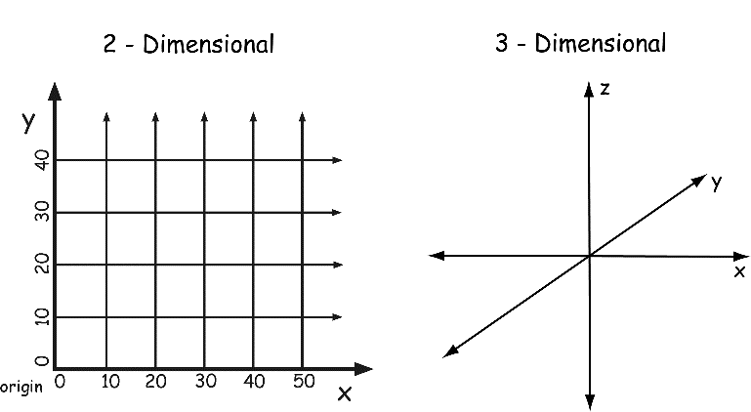
Coordinate Data
GIS often uses a Cartesian coordinate system.
Cartesian Coordinate System (x & y or x, y & z)
Usually specified as decimal numbers that increase from bottom to top.
77
Notes:
A Cartesian coordinate system is fine for mapping over small areas, but for large areas we need to use a spherical coordinate system.

Slide 78
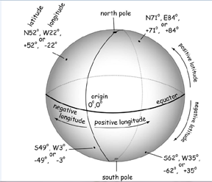
Coordinate Data
Latitude & Longitude
Origin (intersection of the Equator and Greenwich meridian)
Spherical Coordinates
Deg., min., sec. (DMS)
Decimal degrees (DD)
78

Slide 79
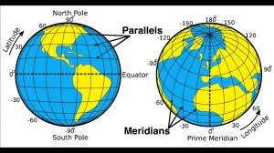
Nomenclature of Geographic Coordinate System
http://www.justtrails.com/nav-skills/navigation-skills-latitude-and-longitude/

Slide 80
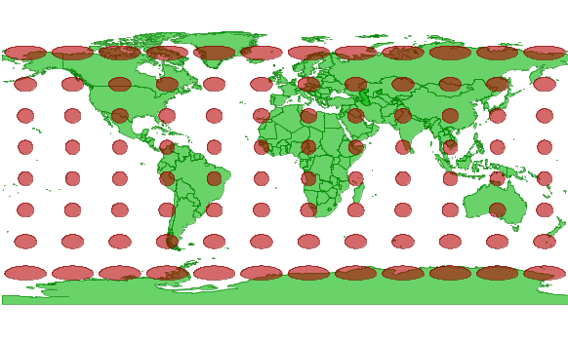
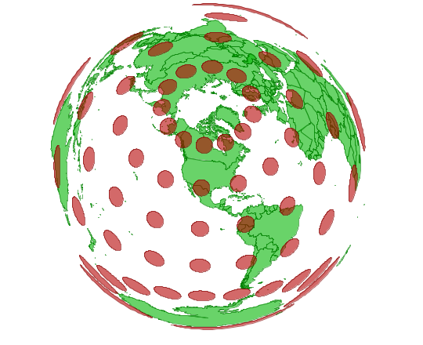
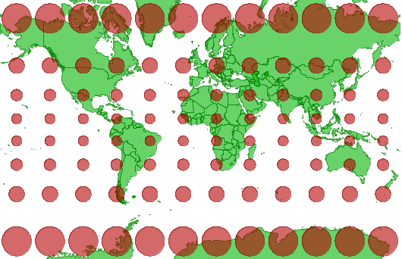
Conversion from Spherical to Cartesian
Tissot’s Indicatrix
http://www.perrygeo.com/tissot-indicatrix-examining-the-distortion-of-map-projections.html
Notes:
Tissot’s Indicatrix

Slide 81
Conversion from DMS to DD
Convert: 68º 40’ 19.2” W to decimal degrees:
81
Notes:
N,E,S,W are used with DMS
+/- are used with DD

Slide 82
Conversion from DD to DMS
68º 48’ 57”
Convert: -68.67200 to degrees, minutes, seconds:
82

Slide 83
Converting Arc to Surface Distance
Where d is the ground distance, r is the radius of the sphere and the angle is specified in radians.

Slide 84
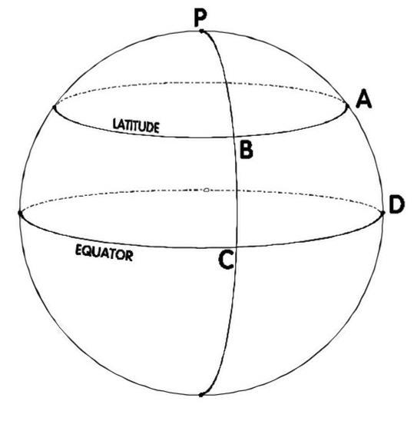
Converting Arc to Surface Distance
At the equator, one degree
of longitude is about 111km
Notes:
This assumes a perfectly spherical Earth

Slide 85
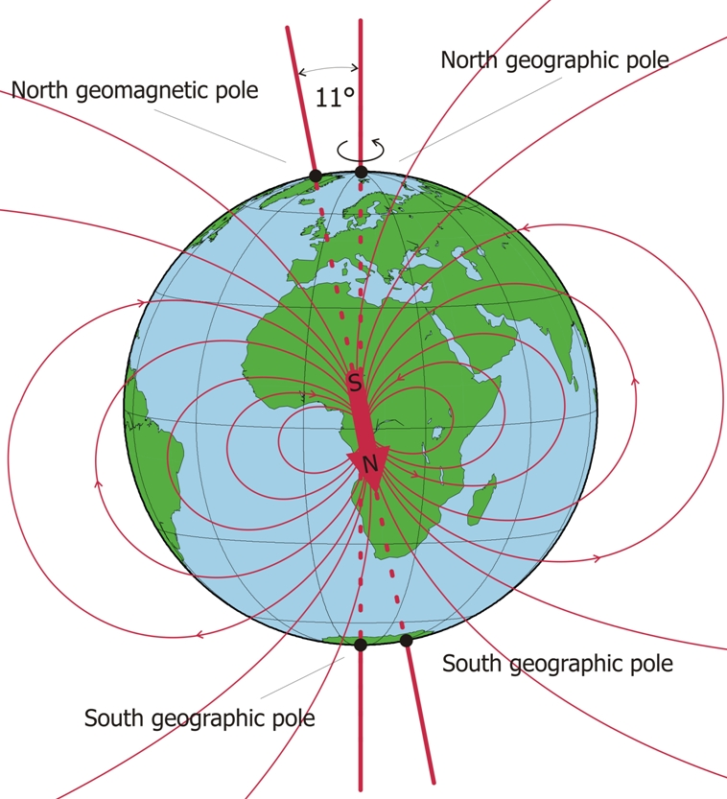
Geographic & Magnetic North
http://www.ingv.it/ufficio-stampa/research-areas/the-earth/characteristics-of-the-earth-s-magnetic-field/view?set_language=en
Notes:
Due to the Earths wobble geographic north as an average value within this “wobble”

Slide 86

Types of Attribute Data
Attribute data record the non-spatial characteristics of an entity.
Attributes have values
Observed
Measured
Llbean.com
86
Notes:
Attributes of a pair of jeans:
Observed: color (dark blue sea salt, style :relaxed fit, slim leg, boot cut)
Measured: size 4,6,8,10, length (short, regular, tall)

Slide 87
Measurement of Attributes
Physical scientists define measurement as the comparison of an object to a standard object.
They define two types of measurements
Extensive/Fundamental Properties (feet)
Derived – by combining extensive properties (feet/second)
87

Slide 88
Stevens’ Levels of Measurement
Social scientists weren’t satisfied with this classification
Stanley Stevens (1946) proposed a framework for measurement types based upon “levels of measurement”.
He defined measurement as being the assignment of classes or scores to phenomena according to a set of rules.
88

Slide 89
Stevens’ Levels of Measurement
There are four basic levels according to Stevens:
Nominal – provides descriptive information.
Ordinal – implies a rank order.
Interval – implies order and difference in magnitude.
Ratio - implies order and difference in magnitude and has an absolute 0.
89
Notes:
The level of measurement determines the calculations and the analysis that can be performed on the data.

Slide 90

Interval
Operations include:
Count
Equality
Order
Addition and Subtraction
Lecture 2

Slide 91

Ratio
Operations:
Count
Equality
Order
Addition and Subtraction
Multiplication and Division
Higher order operations
Lecture 2

Slide 92
Common GIS Data Models
Spatial Data
Vector Data
Raster Data
Non-topological
Topological
Simple Data
Higher-level Data
TIN
Regions
Dynamic Segmentation
92
Notes:
Data Model – A consistent way of defining and representing spatial objects in a database, and of representing the relationships among them

Slide 93
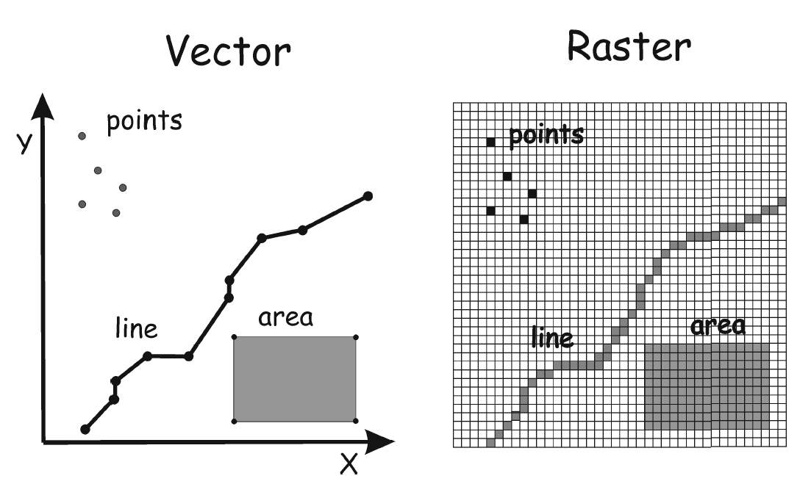
Two Most Common Spatial Data Models
93

Slide 94
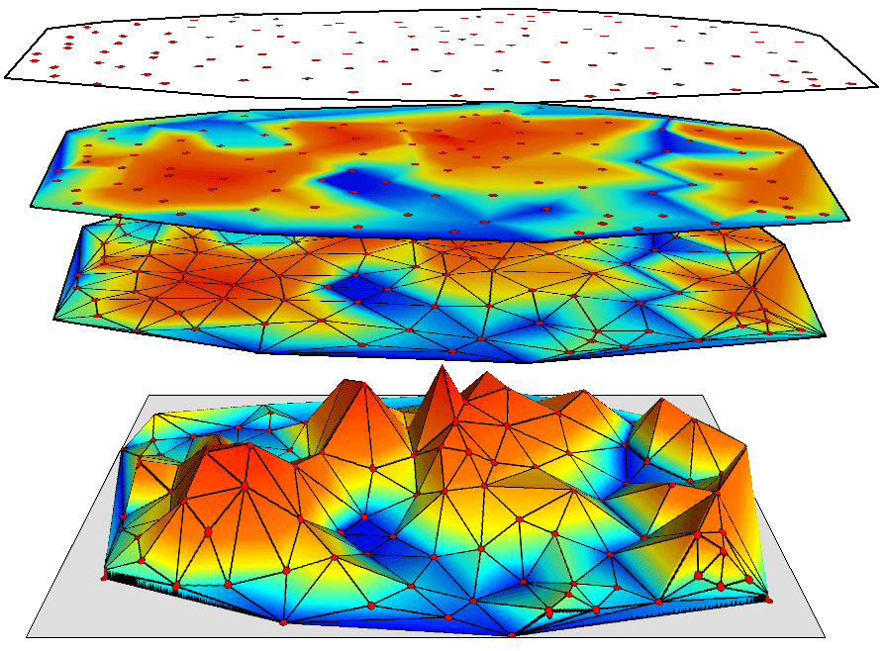
Triangulated Irregular Network (TIN)
http://www.geosolutions.com/3d/analyse/images/interpolate_tin.gif

Slide 95
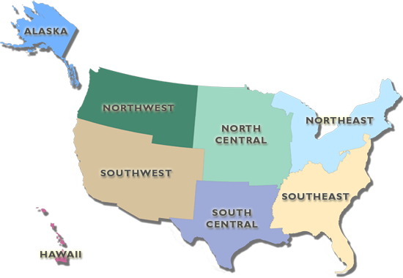
Regions
https://gis1.usgs.gov/csas/gap/viewer/land_cover/Images/Regions.png

Slide 96
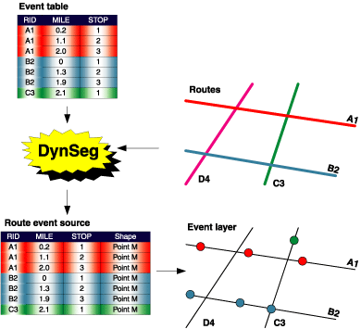
Dynamic Segmentation
Dynamic segmentation is the process of computing the map location (shape) of events stored in an event table. Dynamic segmentation is what allows multiple sets of attributes to be associated with any portion of a linear feature.
http://resources.arcgis.com/en/help/main/10.1/index.html#//003900000026000000

Slide 97
Vector & Raster
Vector is better at representing discrete features.
Raster is better at representing continuous features
A project may contain both vector and raster layers.
Spatial operations can only be performed on one type of layer.
97

Slide 98
Vector & Raster (cont’d)
The best data model for a given layer depends upon the operations, the experience and the views of the user.
No decision is final, as one can be converted to the other.
98
Notes:
Conversion introduces error

Slide 99

Vector Terminology
The terms polygon and area will be used interchangeably.
Lecture 2
Notes:
The level of measurement determines the calculations and the analysis that can be performed on the data.

Slide 100

Multiple Representations

Slide 101

Vector Model

Slide 102

Single Part Features
1 to 1 Relationship

Slide 103
Multipart Features
Many to 1 Relationship
Notes:
The row attribute applies to all parts of the feature,

Slide 104

Multipart to Single-Part Problem

Slide 105
Polygon Inclusions
Areas in polygons that are part of the polygon, but different from the rest of the polygon: e.g. Islands in a lake.
Solutions:
Create separate polygons for each inclusion.
Create an attribute column for coding inclusions.
Lecture 2

Slide 106

Boundary Generalization
The incomplete representation of boundary locations.
http://www.i95exitguide.com/side-trips/the-maine-coastline/

Slide 107

Vector Topology
Topology – geometric properties that to not change
with shape: Adjacency, Connectivity, Containment
Notes:
Early GIS data models were non-topological and so require a lot of careful time consuming editing. The topological data model allows you to set rules such that there can be no overlaps or undershoots.

Slide 108
Three Types of Vector Features
Lecture 2

Slide 109
Advantages of Topology
Maintain correct data spatial relationship (Find errors)
Efficient data storage (quickly process large data sets)
Facilitate spatial analysis (Network analysis, Adjacent area analysis, overlay analysis
Lecture 2

Slide 110

Vector Features, Tables & Structures

Slide 111
Additional Resources on Spatial
https://www.oracle.com/in/database/spatial/

Slide 112
Multimedia Database

Slide 113
Multimedia Database
A Multimedia Database Management System (MMDBMS) is a framework that manages different types of data potentially represented in a wide diversity of formats on a wide array of media sources.
It provides support for multimedia data types, and facilitate for creation, storage, access, query and control of a multimedia database

Slide 114
Types of MM Database
Text
Images
Audio
Video
Animation
Graphic Objects

Slide 115
Content of MMDBMS
Media data – The actual data representing an object.
Media format data – Information such as sampling rate, resolution, encoding scheme etc. about the format of the media data after it goes through the acquisition, processing and encoding phase.
Media keyword data – Keywords description relating to the generation of data. It is also known as content descriptive data. Example: date, time and place of recording.
Media feature data – Content dependent data such as the distribution of colors, kinds of texture and different shapes present in data

Slide 116
Examples of MM Database
Digital Libraries.
News-on-Demand.
Video-on-Demand.
Music database.
Geographic Information Systems (GIS)
Telemedicine.

Slide 117
What are Issues and challenges
Multimedia data consists of a variety of media formats or file representations including TIFF, BMP, PPT, IVUE, FPX, JPEG, MPEG, AVI, MID, WAV, DOC, GIF, EPS, PNG, etc.
Usually, the data size of multimedia is large such as video; therefore, multimedia data often require a large storage.
Multimedia database consume a lot of processing time, as well as bandwidth.

Slide 118
Like the traditional DBMS, MM-DBMS should address requirements:
Integration
Data items do not need to be duplicated for different programs
Data independence
Separate the database and the management from the application programs
Concurrency control
allows concurrent transactions

Slide 119
Requirements of Multimedia DBMS
Persistence
Data objects can be saved and re-used by different transactions and program invocations
Privacy
Access and authorization control
Integrity control
Ensures database consistency between transactions
Recovery
Failures of transactions should not affect the persistent data storage
Query support
Allows easy querying of multimedia data

Slide 120
Requirements of Multimedia DBMS (cont.)
In addition, an MM-DBMS should:
have the ability to uniformly query data (media data, textual data) represented in different formats.
have the ability to simultaneously query different media sources and conduct classical database operations across them.
⇒ query support
have the ability to retrieve media objects from a local storage device in a smooth jitter-free (i.e. continuous) manner.
⇒ storage support
have the ability to take the answer generated by a query and develop a presentation of that answer in terms of audio-visual media.
have the ability to deliver this presentation in a way that satisfies various Quality of Service requirements.
⇒ presentation and delivery support

Slide 121
Content based retrieval
A content-based retrieval system processes the information contained in image data and creates an abstraction of its content in terms of visual attributes. Any query operations deal solely with this abstraction rather than with the image itself. Thus, every image inserted into the database is analyzed, and a compact representation of its content is stored in a feature vector, or signature.

Slide 122
What Are Large Objects?
Large Objects (LOBs) are a set of datatypes that are designed to hold large amounts of data. A LOB can hold up to a maximum size ranging from 8 terabytes to 128 terabytes depending on how your database is configured. Storing data in LOBs enables you to access and manipulate the data efficiently in your application.
Why Use Large Objects?
This section introduces different types of data that you encounter when developing applications and discusses which kinds of data are suitable for large objects.
In the world today, applications must deal with the following kinds of data:
Simple structured data.
This data can be organized into simple tables that are structured based on business rules.
Complex structured data
This kind of data is complex in nature and is suited for the object-relational features of the Oracle database such as collections, references, and user-defined types.

Slide 123
BLOB
A Binary Large OBject (BLOB) is a collection of binary data stored as a single entity in a database management system. Blobs are typically images, audio or other multimedia objects, though sometimes binary executable code is stored as a blob. Database support for blobs is not universal.

Slide 124
Video On demand
Video on demand (display) (VOD) are systems which allow users to select and watch/listen to video or audio content when they choose to, rather than having to watch at a specific broadcast time. IPTV technology is often used to bring video on demand to televisions and personal computers.
IPTV - a service that provides television programming and other video content using the Transmission Control Protocol/Internet Protocol (TCP/IP) suite

Slide 125
A Sample Multimedia Scenario
Consider a police investigation of a large-scale drug operation. This investigation may generate the following types of data
Video data captured by surveillance cameras that record the activities taking place at various locations.
Audio data captured by legally authorized telephone wiretaps.
Image data consisting of still photographs taken by investigators.
Document data seized by the police when raiding one or more places.
Structured relational data containing background information, back records, etc., of the suspects involved.
Geographic information system data remaining geographic data relevant to the drug investigation being conducted.

Slide 126
Possible Queries
Image Query (by example):
Police officer Rocky has a photograph in front of him.
He wants to find the identity of the person in the picture.
Query: “Retrieve all images from the image library in which the person appearing in the (currently displayed) photograph appears”
Image Query (by keywords):
Police officer Rocky wants to examine pictures of “Big Spender”.
Query: "Retrieve all images from the image library in which “Big Spender” appears."

Slide 127
Possible Queries (cont.)
Video Query:
Police officer Rocky is examining a surveillance video of a particular person being fatally assaulted by an assailant. However, the assailant's face is occluded and image processing algorithms return very poor matches. Rocky thinks the assault was by someone known to the victim.
Query: “Find all video segments in which the victim of the assault appears.”
By examining the answer of the above query, Rocky hopes to find other people who have previously interacted with the victim.
Heterogeneous Multimedia Query:
Find all individuals who have been photographed with “Big Spender” and who have been convicted of attempted murder in South China and who have recently had electronic fund transfers made into their bank accounts from ABC Corp.

Slide 128

MM Database Architectures
Based on Principle of Autonomy
Each media type is organized in a media-specific manner suitable for that media type
Need to compute joins across
different data structures
Relatively fast query
processing due to
specialized structures
The only choice for legacy
data banks

Slide 129

MM Database Architectures (cont.)
Based on Principle of Uniformity
A single abstract structure to index all media types
Abstract out the common part of different media types (difficult!) - metadata
One structure - easy implementation
Annotations for different
media types

Slide 130

MM Database Architectures (cont.)
Based on Principle of Hybrid Organization
A hybrid of the first two. Certain media types use their own indexes, while others use the "unified" index
An attempt to capture
the advantages of the
first two
Joins across multiple
data sources using their
native indexes

Slide 131
Organizing Multimedia Data Based on the Principle of Uniformity
Consider the following statements about media data and they may be made by a human or may be produced by the output of an image/video/text content retrieval engine.
The image photol.gif shows Jane Shady, “Big Spender” and an unidentified third person, in Sheung Shui. The picture was taken on January 5, 1997.
The video-clip videol.mpg shows Jane Shady giving “Big Spender” a briefcase (in frames 50-100). The video was obtained from surveillance set up at Big Spender’s house in Kowloon Tong, in October, 1996.
The document bigspender.txt contains background information on Big Spender, a police’s file.

Slide 132
Metadata and Media Abstraction
All these statements are Meta-data statements.
Associate, with each media object o_{i}, some meta-data, md(o_{i})
If our archive contains objects o₁,..., o_{n}, then index the meta data md(o₁),..., md(o_{n}) in a way that provides efficient ways of implementing the expected accesses that users will make.
We expect to take use of a single data structure to represent metadata
This can be achieved via media abstractions
Media abstractions are mathematical structure representing such media content.
Let’s consider a simple multimedia database system (SMDS) hereafter!

Slide 133
Querying SMDSs (Uniform Representation)
Querying SMDS based on top of SQL. Basic functions include:
FindType(Obj): This function takes a media object Obj as input, and returns the output type of the object. For example,
FindType(iml.gif) = gif.
FindType(moviel.mpg) = mpg.
FindObjWithFeature(f): This function takes a feature f as input and returns as output, the set of all media objects that contain that feature. For example,
FindObjWithFeature(john)= {iml.gif,im2.gif,im3.gif,videol.mpg:[1,5]}. FindObjWithFeature(mary)= {videol.mpg:[1,5],videol.mpg:[15,50]}.

Slide 134
Querying SMDSs (Uniform Representation) (cont.)
FindObjWithFeatureandAttr(f,a,v): This function takes as input, a feature f, an attribute name a associated with that feature, and a value v. It returns as output, all objects obj that contain the feature and such the value of the attribute a in object obj is v. E.g.
FindObjWithFeatureandAttr(Big Spender,suit,blue): This query asks to find all media objects in which Big Spender appears in a blue suit.
FindFeaturesinObj(Obj): This query asks to find all features that occur within a given media object. It returns as output, the set of all such features. For example,
FindFeaturesinObj (iml.gif): This asks for all features within the image file iml.gif. It may return as output, the objects John, and Lisa.
FindFeaturesinObj(videol.mpg:[1,15]): This asks for all features within the first 15 frames of the video file videol.mpg. The answer may include objects such as Mary and John.

Slide 135

Querying SMDSs (Uniform Representation) (cont.)
FindFeaturesandAttrinObj(Obj): This query is exactly like the previous query except that it returns as output, a relation having the scheme
(Feature,Attribute,Value)
where the triple (f,a,v) occurs in the output relation iff feature f occurs in the query FindFeaturesinObj(Obj) and feature f's attribute a is defined and has value v. For example,
FindFeaturesandAttrinObj(iml.gif) may return as answer, the table

Slide 136
Querying SMDS by SMDS-SQL
All ordinary SQL statements are SMDS-SQL statements. In addition:
The SELECT statement may contain media-entities. A media entity is defined as follows:
If m is a continuous media object, and i, j are integers, then m:[i, j] is a media-entity denoting the set of all frames of media object m that lie between (and inclusive of) segments i, j.
If m is not a continuous media object, them m is a media entity.
If m is a media entity, and a is an attribute of m, then m.a is a media-entity.
The FROM statement may contain entries of the form
<media> <source> <M>
which says that only media-objects associate with the named media type and named data source are to be considered when processing the query, and that M is a variable ranging over such media objects.

Slide 137
Querying SMDS by SMDS-SQL (cont)
The WHERE statement allows (in addition to standard SQL constructs), expressions of the form
term IN func_ca11
where
term is either a variable (in which case it ranges over the output type of func_call) or an object having the same output type as func_call and
func_call is any of the five function calls stated above

Slide 138
Sample SMDS-SQL Statements
Find all image/video objects containing both Jane Shady and Big Spender. This can be expressed as the SMDS-SQL query:
SELECT M
FROM smds source1 M
WHERE (FindType(M)=Video OR FindType(M)=Image)
AND
M IN FindObjWithFeature(Big Spender)
AND
M IN FindObjWithFeature(Jane Shady).

Slide 139
Sample SMDS-SQL Statements (cont.)
Find all image/video objects containing Big Spender wearing a purple suit. This can be expressed as the SMDS-SQL query:
SELECT M
FROM smds sourcel M
WHERE (FindType(M)=Video OR FindType(M)=Image)
AND
M IN FindObjWithFeatureandAttr(Big Spender, suit, purple)

Slide 140
Sample SMDS-SQL Statements (cont.)
Find all images containing Jane Shady and a person who appears in a video with Big Spender. Unlike the preceding queries this query involves computing a "join" like operations across different data domains. In order to do this, we use existential variables such as the variable "Person" in the query below, which is used to refer to the existence of an unknown person whose identity is to be determined.
SELECT M,Person
FROM smds sourcel M,M1
WHERE (FindType(M)=Image) AND
(FindType(M1)=Video) AND
M IN FindObjWithFeature(Jane Shady) AND
M1 IN FindObjWithFeature(Big Spender) AND
Person IN FindFeaturesinObj (M) AND
Person IN FindFeaturesinObj (M1) AND
Person≠Jane Shady AND Person≠Big Spender

Slide 141
Querying SMDSs (Hybrid Representation)
SMDS-SQL may be used to query multimedia objects which are stored in the uniform representation.
“What is it about the hybrid representation that causes our query language to change?”
In the uniform representation, all the data sources being queried are SMDSs, while in the hybrid representation, different (non-SMDS) representations may be used.
A hybrid media representation basically consists of two parts - a set of media objects that use the uniform representation (which we have already treated in the preceding section), and a set of media-types that use their own specialized access structures and query language.

Slide 142
Querying SMDSs (Uniform Representation) (cont.)
To extend SMDS-SQL to Hybrid-Multimedia SQL (HM-SQL for short), we need to do two things:
First, HM-SQL, must have the ability to express queries in each of the specialized languages used by these non-SMDS sources
Second, HM-SQL, must have the ability to express “joins” and other similar binary algebraic operations between SMDS sources and non-SMDS sources

Slide 143



Image Processing
Image Enhancement

Slide 144

Image Processing (cont’d)
Image Restoration(e.g., correcting out-focus images)

Slide 145

Image Processing (cont’d)
Image Compression

Slide 146


Computer Graphics
Geometric modeling

Slide 147


Face Detection

Slide 148
Automated Image Analysis
Automated image analysis uses finely tuned software to extract data from digital images. Algorithms recognize specific shapes and patterns in the images and gather quantitative information that is then used for further data analysis

Slide 149
Image Analysis Tools
Image analysis software, also known as image recognition or computer vision, processes images to extract details using artificial intelligence. Machine learning algorithms can be used to identify anything – which provides a variety of applications for brands.

Slide 150
Object Recognition in Image Processing
Object recognition is a computer vision technique for identifying objects in images or videos. Object recognition is a key output of deep learning and machine learning algorithms.

Slide 151
Tagging of Images
Image tagging is the process of identifying and labeling the contents of an image.
This can be done manually by someone looking at the image and typing in a description, or done automatically using machine learning technology.

Slide 152
Additional Reading in Multimedia Database
https://docs.oracle.com/cd/E11882_01/appdev.112/e10777/ch_examples.htm#IMURG11690

